Slide 1

Computer Programming for Engineers
Week 8 Lecture 1
Oct. 18, 2022
Lecturer: Mohammad Mahdi Javidan
College of Engineering, Sungkyunkwan University
Fall Semester 2022

Slide 2


Monte Carlo Methods
Monte Carlo methods, or Monte Carlo experiments, are a broad class of computational algorithms that rely on repeated random sampling to obtain numerical results.
A sample space is the set of all possible outcomes or results of that experiment
An event is a set of outcomes of an experiment (a subset of the sample space) to which a probability is assigned.
Dice roll:
The sample space has 6 elements
Sample space
1 | 2 | 3 | 4 | 5 | 6
College of Engineering, Sungkyunkwan University

Slide 3

Monte Carlo Methods
Rolling a six-sided dice twice
Sample space
 | 1 | 2 | 3 | 4 | 5 | 6
1 | (1,1) | (1,2) | (1,3) | (1,4) | (1,5) | (1,6)
2 | (2,1) | (2,2) | (2,3) | (2,4) | (2,5) | (2,6)
3 | (3,1) | (3,2) | (3,3) | (3,4) | (3,5) | (3,6)
4 | (4,1) | (4,2) | (4,3) | (4,4) | (4,5) | (4,6)
5 | (5,1) | (5,2) | (5,3) | (5,4) | (5,5) | (5,6)
6 | (6,1) | (6,2) | (6,3) | (6,4) | (6,5) | (6,6)
College of Engineering, Sungkyunkwan University

Slide 4


Monte Carlo Methods
Repeating the experiment 100 times
Finding the sample space
College of Engineering, Sungkyunkwan University

Slide 5
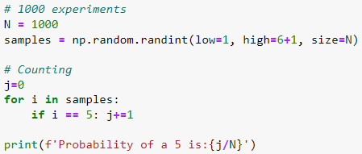
Monte Carlo Methods
Frequentism is an interpretation of probability; it defines an event's probability as the limit of its relative frequency in many trials
Repeating the experiment 1000 times
Probability of rolling a 5
College of Engineering, Sungkyunkwan University

Slide 6
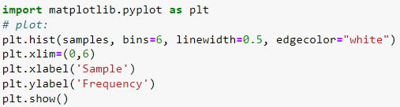
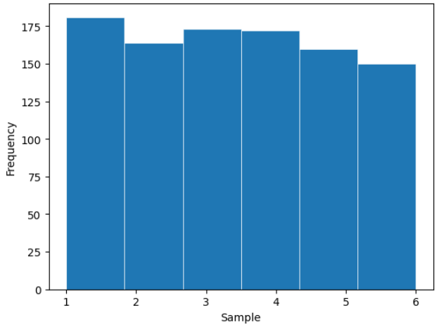
Monte Carlo Methods
A Histogram is an approximate representation of the distribution of numerical data
College of Engineering, Sungkyunkwan University

Slide 7



Monte Carlo Methods
Simulation of rolling two dice
Sample space
College of Engineering, Sungkyunkwan University

Slide 8
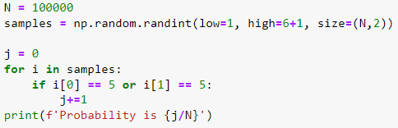

Monte Carlo Methods
Probability of a 5 in rolling two dice
Sample space
 | 1 | 2 | 3 | 4 | 5 | 6
1 | (1,1) | (1,2) | (1,3) | (1,4) | (1,5) | (1,6)
2 | (2,1) | (2,2) | (2,3) | (2,4) | (2,5) | (2,6)
3 | (3,1) | (3,2) | (3,3) | (3,4) | (3,5) | (3,6)
4 | (4,1) | (4,2) | (4,3) | (4,4) | (4,5) | (4,6)
5 | (5,1) | (5,2) | (5,3) | (5,4) | (5,5) | (5,6)
6 | (6,1) | (6,2) | (6,3) | (6,4) | (6,5) | (6,6)
$$p=\frac{11}{36}=0.30\overline{5}$$
College of Engineering, Sungkyunkwan University

Slide 9
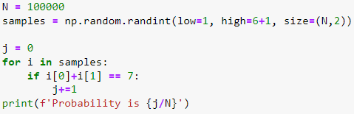

Monte Carlo Methods
What is the probability that the sum of the two dice is seven?
Sample space
 | 1 | 2 | 3 | 4 | 5 | 6
1 | (1,1) | (1,2) | (1,3) | (1,4) | (1,5) | (1,6)
2 | (2,1) | (2,2) | (2,3) | (2,4) | (2,5) | (2,6)
3 | (3,1) | (3,2) | (3,3) | (3,4) | (3,5) | (3,6)
4 | (4,1) | (4,2) | (4,3) | (4,4) | (4,5) | (4,6)
5 | (5,1) | (5,2) | (5,3) | (5,4) | (5,5) | (5,6)
6 | (6,1) | (6,2) | (6,3) | (6,4) | (6,5) | (6,6)
$$p=\frac{6}{36}=0.16\overline{6}$$
College of Engineering, Sungkyunkwan University

Slide 10

Monte Carlo Methods
What is the probability that the two numbers are different?
Sample space
 | 1 | 2 | 3 | 4 | 5 | 6
1 | (1,1) | (1,2) | (1,3) | (1,4) | (1,5) | (1,6)
2 | (2,1) | (2,2) | (2,3) | (2,4) | (2,5) | (2,6)
3 | (3,1) | (3,2) | (3,3) | (3,4) | (3,5) | (3,6)
4 | (4,1) | (4,2) | (4,3) | (4,4) | (4,5) | (4,6)
5 | (5,1) | (5,2) | (5,3) | (5,4) | (5,5) | (5,6)
6 | (6,1) | (6,2) | (6,3) | (6,4) | (6,5) | (6,6)
$$p=\frac{6×5}{6×6}=0.83\overline{3}$$
College of Engineering, Sungkyunkwan University

Slide 11
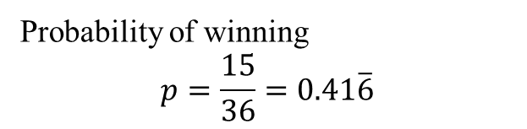
Monte Carlo Methods
You play against the house.
You both roll your dice and if you get a strictly higher number you win.
Each time you bet $10
Simulate 100 rolls and draw your balance
Sample space
 | 1 | 2 | 3 | 4 | 5 | 6
1 | (1,1) | (1,2) | (1,3) | (1,4) | (1,5) | (1,6)
2 | (2,1) | (2,2) | (2,3) | (2,4) | (2,5) | (2,6)
3 | (3,1) | (3,2) | (3,3) | (3,4) | (3,5) | (3,6)
4 | (4,1) | (4,2) | (4,3) | (4,4) | (4,5) | (4,6)
5 | (5,1) | (5,2) | (5,3) | (5,4) | (5,5) | (5,6)
6 | (6,1) | (6,2) | (6,3) | (6,4) | (6,5) | (6,6)
Probability of winning
$$p=\frac{15}{36}=0.41\overline{6}$$
College of Engineering, Sungkyunkwan University

Slide 12
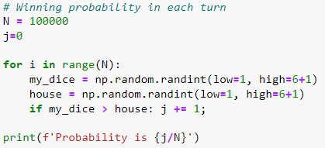
Monte Carlo Methods
Find the probability of winning in each turn using Monte Carlo Simulation
College of Engineering, Sungkyunkwan University

Slide 13
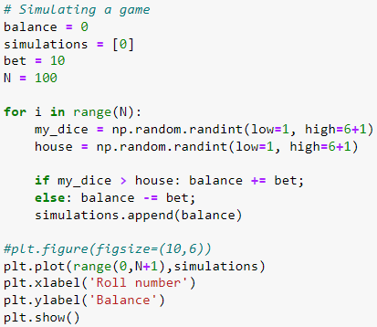
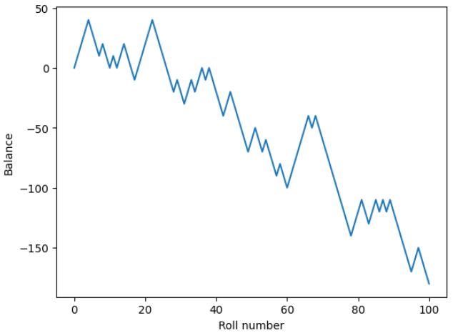
Monte Carlo Methods
Simulate 100 rolls and draw your balance
College of Engineering, Sungkyunkwan University

